Slide 1


WSQ COURSEWARE
Navigating Digital Threats: Proactive Measures Against Cyber Frauds and Scams
TGS-2024043420 ACC-ICT-3002-1.1 Cyber Security Version v10.0
Tertiary Infotech Academy Pte Ltd · UEN 201200696W
Navigating Digital Threats · TGS-2024043420
© 2026 Tertiary Infotech Academy Pte Ltd
1

Slide 2
COURSE ADMINISTRATION
ADMIN
Digital Attendance
Complete AM, PM and assessment attendance through the trainer-provided SSG QR.
1
AM session
2
PM session
Scan only the current trainer-displayed code.
Repeat after lunch for the afternoon session.
3
Assessment
4
Evidence
Complete the separate assessment attendance.
Confirm the accepted attendance state before leaving.
Navigating Digital Threats · TGS-2024043420
© 2026 Tertiary Infotech Academy Pte Ltd
Source: tertiarycourses.com.sg
2

Slide 3
COURSE ADMINISTRATION
ADMIN
General Trainer Profile
Use a consistent visual profile for the assigned trainer.
1
Name
2
Credentials
Insert assigned trainer name.
List relevant qualifications and certifications.
3
Experience
4
Contact
State industry and adult-learning experience.
Provide the approved contact route.
Navigating Digital Threats · TGS-2024043420
© 2026 Tertiary Infotech Academy Pte Ltd
Source: tertiarycourses.com.sg
3

Slide 4
COURSE ADMINISTRATION
ADMIN
About Dr Alfred Ang
Courseware lead and trainer for applied digital-risk learning.
1
Role
2
Coverage
Founder and adult educator.
AI, cloud and cybersecurity.
3
Method
4
Contact
Evidence-led applied learning.
Use the official academy channel.
Navigating Digital Threats · TGS-2024043420
© 2026 Tertiary Infotech Academy Pte Ltd
Source: tertiarycourses.com.sg
4

Slide 5
COURSE ADMINISTRATION
ADMIN
Ground Rules
Protect people and data while practising scam analysis.
1
Simulated data
2
Safe handling
Use only the supplied fictional evidence.
Do not open live suspect links or files.
3
Evidence first
4
Participate
Support decisions with observable facts.
Share reasoning without exposing personal data.
Navigating Digital Threats · TGS-2024043420
© 2026 Tertiary Infotech Academy Pte Ltd
Source: tertiarycourses.com.sg
5

Slide 6
COURSE ADMINISTRATION
ADMIN
Course Schedule
One focused day from recognition through response.
1
Morning
2
Midday
Attack chains, signals and verification.
Account, device and payment controls.
3
Afternoon
4
Assessment
Response, evidence and escalation.
One hour: WA followed by Case Study.
Navigating Digital Threats · TGS-2024043420
© 2026 Tertiary Infotech Academy Pte Ltd
Source: tertiarycourses.com.sg
6

Slide 7
COURSE ADMINISTRATION
ADMIN
Skills Framework
ACC-ICT-3002-1.1 Cyber Security
1
A1
2
A2
Identify cyber risks and threats.
Protect personal and business information.
3
A3
4
Evidence
Interpret and escalate incidents.
Apply controls through eight activities.
Navigating Digital Threats · TGS-2024043420
© 2026 Tertiary Infotech Academy Pte Ltd
Source: tertiarycourses.com.sg
7

Slide 8
COURSE ADMINISTRATION
ADMIN
Learning Outcomes
Move from recognition to action with defensible evidence.
1
LO1
2
LO2
Identify potential fraud and scam threats.
Protect information, accounts and funds.
3
LO3
4
Transfer
Interpret and escalate verified incidents.
Apply the same reasoning to new scenarios.
Navigating Digital Threats · TGS-2024043420
© 2026 Tertiary Infotech Academy Pte Ltd
Source: tertiarycourses.com.sg
8

Slide 9
COURSE ADMINISTRATION
ADMIN
Courseware and Assessment on the LMS
Use the LMS as the single learner access point.
1
Courseware
2
Activities
Download slides and Learner Guide.
Open the eight activity folders.
3
Assessment
4
Submission
Access WA and Case Study papers.
Upload answers through the assigned course record.
Navigating Digital Threats · TGS-2024043420
© 2026 Tertiary Infotech Academy Pte Ltd
Source: tertiarycourses.com.sg
9

Slide 10
COURSE ADMINISTRATION
ADMIN
Assessment Briefing
Demonstrate reasoning, evidence and control selection.
1
Written Assessment
2
Case Study
Three open-ended questions, K1–K3.
One scenario, three questions, A1–A3.
3
Resources
4
Standard
Open book using approved materials.
Address every criterion with evidence.
Navigating Digital Threats · TGS-2024043420
© 2026 Tertiary Infotech Academy Pte Ltd
Source: tertiarycourses.com.sg
10

Slide 11
COURSE ADMINISTRATION
PROCESS
Assessment Flow
1
2
3
4
5
TRAQOM
Assessment attendance
WA then CS
Submit on LMS
Sign summary
Scan the LMS QR
Complete the SSG record
3 questions each
Upload responses
Review result and feedback
ATTENDANCE
MANDATORY
OPEN BOOK
EVIDENCE
RECORD
Candidate papers are learner-facing; answer keys remain trainer-only.
Navigating Digital Threats · TGS-2024043420
© 2026 Tertiary Infotech Academy Pte Ltd
Source: lms-tms.tertiaryinfotech.com
11

Slide 12
COURSE ADMINISTRATION
ADMIN
Assessment and Funding
Completion depends on attendance and demonstrated competence.
1
Attendance
2
Assessment
Meet the required course attendance.
Attempt all prescribed instruments.
3
Competence
4
Records
Achieve competent evidence for every criterion.
Complete required declarations and sign-off.
Navigating Digital Threats · TGS-2024043420
© 2026 Tertiary Infotech Academy Pte Ltd
Source: tertiarycourses.com.sg
12

Slide 13
COURSE ADMINISTRATION
ADMIN
Safety Boundary
Analyse safely without interacting with real threats.
1
Links
2
Data
Never open a live suspicious URL.
Never submit real personal or banking data.
3
Credentials
4
Devices
Never share passwords, OTPs or recovery codes.
Use supplied screenshots and fictional cases.
Navigating Digital Threats · TGS-2024043420
© 2026 Tertiary Infotech Academy Pte Ltd
Source: tertiarycourses.com.sg
13

Slide 14

TOPIC 01
Identify Cyber Frauds and Scams
Trace how contact becomes trust, action and loss; then break the attacker-controlled path.
01
Navigating Digital Threats · TGS-2024043420
© 2026 Tertiary Infotech Academy Pte Ltd
14

Slide 15
SINGAPORE EVIDENCE
CHART
Annual scam and cybercrime cases
READ THE SIGNAL
2025 improved from 2024, but 37,308 scam cases still require consistent prevention and verification.
Decision rule
Verify the specific claim through an independent route.
Navigating Digital Threats · TGS-2024043420
© 2026 Tertiary Infotech Academy Pte Ltd
Source: police.gov.sg
15

Slide 16
SINGAPORE EVIDENCE
CHART
Scam losses remain material
READ THE SIGNAL
Loss reduction does not remove personal exposure. A small number of high-loss incidents can dominate outcomes.
Decision rule
Verify the specific claim through an independent route.
Navigating Digital Threats · TGS-2024043420
© 2026 Tertiary Infotech Academy Pte Ltd
Source: police.gov.sg
16

Slide 17
SINGAPORE EVIDENCE
CHART
First-half scam cases
READ THE SIGNAL
The first-half count declined again in 2026, while attackers continued shifting channels and pretexts.
Decision rule
Verify the specific claim through an independent route.
Navigating Digital Threats · TGS-2024043420
© 2026 Tertiary Infotech Academy Pte Ltd
Source: police.gov.sg
17

Slide 18
SINGAPORE EVIDENCE
CHART
2025 victim average loss by age
READ THE SIGNAL
Average losses rise across the reported age groups. Controls must protect both frequent and high-impact targets.
Decision rule
Verify the specific claim through an independent route.
Navigating Digital Threats · TGS-2024043420
© 2026 Tertiary Infotech Academy Pte Ltd
Source: police.gov.sg
18

Slide 19
SINGAPORE EVIDENCE
CHART
2025 high-volume scam types
READ THE SIGNAL
Different pretexts converge on the same actions: disclose, install, authenticate, pay or forward funds.
Decision rule
Verify the specific claim through an independent route.
Navigating Digital Threats · TGS-2024043420
© 2026 Tertiary Infotech Academy Pte Ltd
Source: police.gov.sg
19

Slide 20
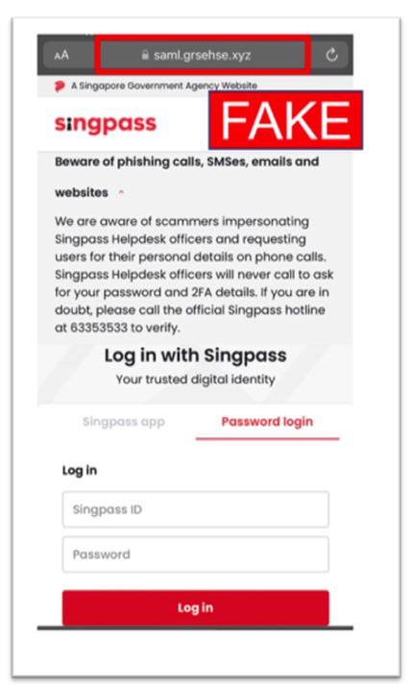
TECHNICAL MECHANISM
ARCH
Phishing: attack chain
ENTRY
TRUST
ACTION
LOSS
Spoofed email or site
sender-domain mismatch
credential or card capture
money · access · identity
OBSERVABLE SIGNALS
sender-domain mismatch; login link; authentication-code request
Source-deck evidence
Break the path before disclosure, installation, authentication or payment.
Navigating Digital Threats · TGS-2024043420
© 2026 Tertiary Infotech Academy Pte Ltd
Source: police.gov.sg
20

Slide 21
EVIDENCE MODEL
MODEL
Phishing: signal model
1
CHANNEL
2
PRESSURE
3
ACTION
How did it arrive?
What emotion is engineered?
What must you do?
Account, number, domain, redirect and device context
Authority, urgency, scarcity, fear, reward or secrecy
Disclose, install, authenticate, pay, forward or stay connected
DECIDE: move to an independently obtained contact route before taking the requested action.
Navigating Digital Threats · TGS-2024043420
© 2026 Tertiary Infotech Academy Pte Ltd
Source: occ.gov
21

Slide 22
WORKED CASE
CASE
Phishing: evidence-led decision
CLAIM
Record exactly what the sender says. Identity cues remain unverified.
EVIDENCE
Capture sender, domain, number, URL, payment route, requested authentication and timing.
DISPOSITION
Block and report when independent verification fails or the requested action is high risk.
Inspect the source-deck artifact at readable scale
A polished message can still be fraudulent; the decision rests on verified evidence and action risk.
Navigating Digital Threats · TGS-2024043420
© 2026 Tertiary Infotech Academy Pte Ltd
Source: fortinet.com
22

Slide 23
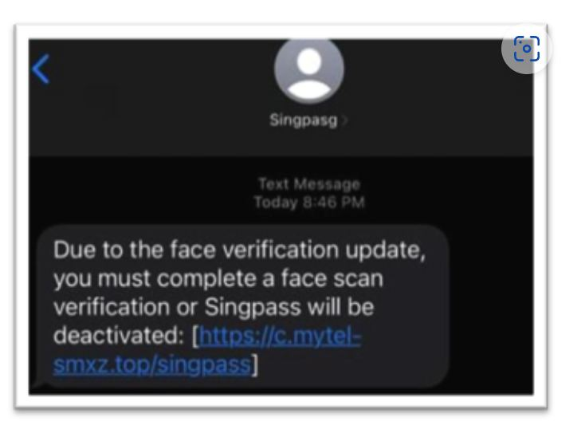
TECHNICAL MECHANISM
ARCH
Smishing: attack chain
ENTRY
TRUST
ACTION
LOSS
Malicious SMS or chat
unknown sender
mobile-first credential capture
money · access · identity
OBSERVABLE SIGNALS
unknown sender; shortened link; delivery or refund pretext
Source-deck evidence
Break the path before disclosure, installation, authentication or payment.
Navigating Digital Threats · TGS-2024043420
© 2026 Tertiary Infotech Academy Pte Ltd
Source: police.gov.sg
23

Slide 24
EVIDENCE MODEL
MODEL
Smishing: signal model
1
CHANNEL
2
PRESSURE
3
ACTION
How did it arrive?
What emotion is engineered?
What must you do?
Account, number, domain, redirect and device context
Authority, urgency, scarcity, fear, reward or secrecy
Disclose, install, authenticate, pay, forward or stay connected
DECIDE: move to an independently obtained contact route before taking the requested action.
Navigating Digital Threats · TGS-2024043420
© 2026 Tertiary Infotech Academy Pte Ltd
Source: occ.gov
24

Slide 25
WORKED CASE
CASE
Smishing: evidence-led decision
CLAIM
Record exactly what the sender says. Identity cues remain unverified.
EVIDENCE
Capture sender, domain, number, URL, payment route, requested authentication and timing.
DISPOSITION
Block and report when independent verification fails or the requested action is high risk.
Inspect the source-deck artifact at readable scale
A polished message can still be fraudulent; the decision rests on verified evidence and action risk.
Navigating Digital Threats · TGS-2024043420
© 2026 Tertiary Infotech Academy Pte Ltd
Source: fortinet.com
25

Slide 26
TECHNICAL MECHANISM
ARCH
Vishing: attack chain
ENTRY
TRUST
ACTION
LOSS
TRUST BOUNDARY
Impersonation call
caller-ID trust
coerced disclosure or transfer
money · access · identity
!
OBSERVABLE SIGNALS
caller-ID trust; authority claim; secrecy; stay-on-line pressure
Stop and verify outside the sender-controlled channel
Break the path before disclosure, installation, authentication or payment.
Navigating Digital Threats · TGS-2024043420
© 2026 Tertiary Infotech Academy Pte Ltd
Source: police.gov.sg
26

Slide 27
EVIDENCE MODEL
MODEL
Vishing: signal model
1
CHANNEL
2
PRESSURE
3
ACTION
How did it arrive?
What emotion is engineered?
What must you do?
Account, number, domain, redirect and device context
Authority, urgency, scarcity, fear, reward or secrecy
Disclose, install, authenticate, pay, forward or stay connected
DECIDE: move to an independently obtained contact route before taking the requested action.
Navigating Digital Threats · TGS-2024043420
© 2026 Tertiary Infotech Academy Pte Ltd
Source: occ.gov
27

Slide 28
WORKED CASE
CASE
Vishing: evidence-led decision
EVIDENCE BOARD
CLAIM
Record exactly what the sender says. Identity cues remain unverified.
SENDER
CHANNEL
identity cue
origin and redirect
EVIDENCE
Capture sender, domain, number, URL, payment route, requested authentication and timing.
ACTION
ROUTE
data, access or payment
trusted verification
DISPOSITION
Block and report when independent verification fails or the requested action is high risk.
Record facts before deciding
A polished message can still be fraudulent; the decision rests on verified evidence and action risk.
Navigating Digital Threats · TGS-2024043420
© 2026 Tertiary Infotech Academy Pte Ltd
Source: fortinet.com
28

Slide 29
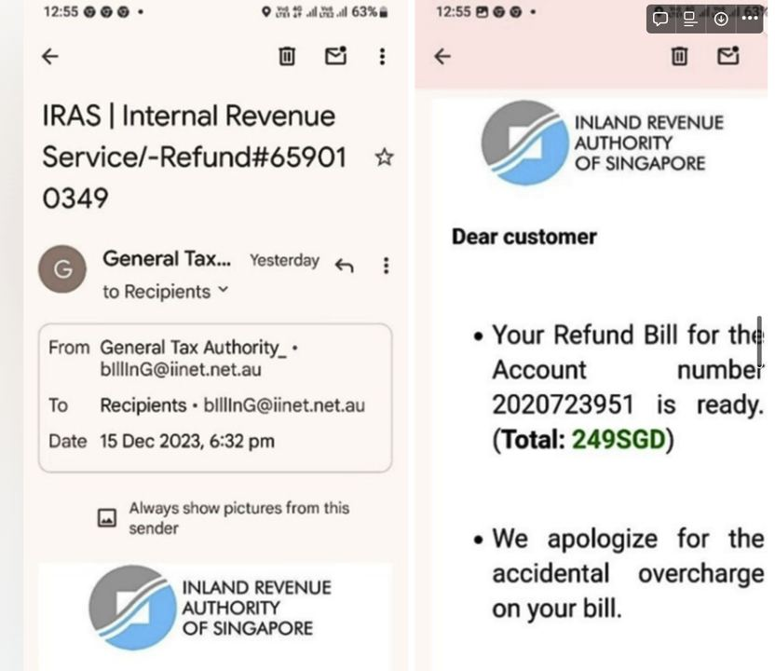
TECHNICAL MECHANISM
ARCH
Government impersonation: attack chain
ENTRY
TRUST
ACTION
LOSS
False official investigation
threat of arrest
transfer to a safe account
money · access · identity
OBSERVABLE SIGNALS
threat of arrest; transfer demand; remote interview
Source-deck evidence
Break the path before disclosure, installation, authentication or payment.
Navigating Digital Threats · TGS-2024043420
© 2026 Tertiary Infotech Academy Pte Ltd
Source: police.gov.sg
29

Slide 30
EVIDENCE MODEL
MODEL
Government impersonation: signal model
1
CHANNEL
2
PRESSURE
3
ACTION
How did it arrive?
What emotion is engineered?
What must you do?
Account, number, domain, redirect and device context
Authority, urgency, scarcity, fear, reward or secrecy
Disclose, install, authenticate, pay, forward or stay connected
DECIDE: move to an independently obtained contact route before taking the requested action.
Navigating Digital Threats · TGS-2024043420
© 2026 Tertiary Infotech Academy Pte Ltd
Source: occ.gov
30

Slide 31
WORKED CASE
CASE
Government impersonation: evidence-led decision
CLAIM
Record exactly what the sender says. Identity cues remain unverified.
EVIDENCE
Capture sender, domain, number, URL, payment route, requested authentication and timing.
DISPOSITION
Block and report when independent verification fails or the requested action is high risk.
Inspect the source-deck artifact at readable scale
A polished message can still be fraudulent; the decision rests on verified evidence and action risk.
Navigating Digital Threats · TGS-2024043420
© 2026 Tertiary Infotech Academy Pte Ltd
Source: fortinet.com
31

Slide 32
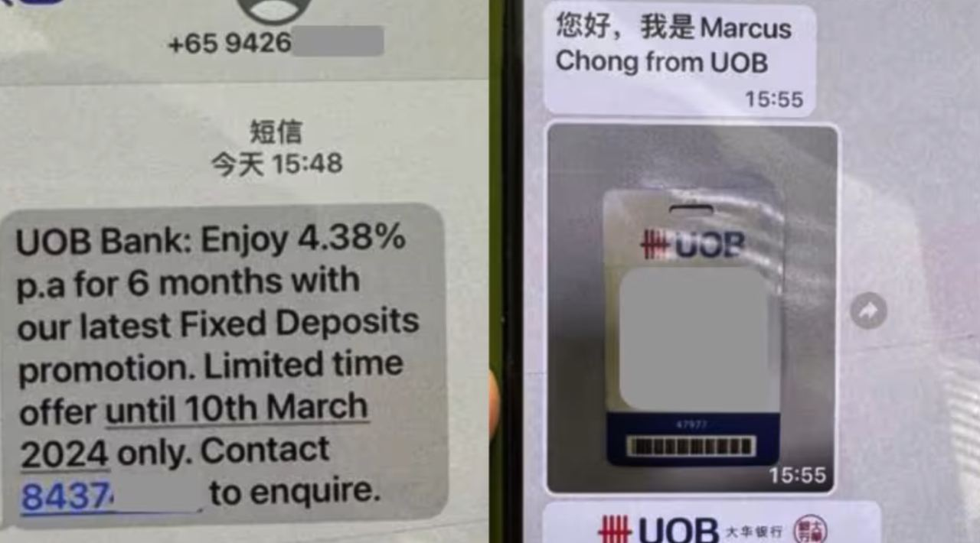
TECHNICAL MECHANISM
ARCH
Bank impersonation: attack chain
ENTRY
TRUST
ACTION
LOSS
False fraud alert
urgent reversal
OTP or digital-token takeover
money · access · identity
OBSERVABLE SIGNALS
urgent reversal; app install; authentication request
Source-deck evidence
Break the path before disclosure, installation, authentication or payment.
Navigating Digital Threats · TGS-2024043420
© 2026 Tertiary Infotech Academy Pte Ltd
Source: police.gov.sg
32

Slide 33
EVIDENCE MODEL
MODEL
Bank impersonation: signal model
1
CHANNEL
2
PRESSURE
3
ACTION
How did it arrive?
What emotion is engineered?
What must you do?
Account, number, domain, redirect and device context
Authority, urgency, scarcity, fear, reward or secrecy
Disclose, install, authenticate, pay, forward or stay connected
DECIDE: move to an independently obtained contact route before taking the requested action.
Navigating Digital Threats · TGS-2024043420
© 2026 Tertiary Infotech Academy Pte Ltd
Source: occ.gov
33

Slide 34
WORKED CASE
CASE
Bank impersonation: evidence-led decision
CLAIM
Record exactly what the sender says. Identity cues remain unverified.
EVIDENCE
Capture sender, domain, number, URL, payment route, requested authentication and timing.
DISPOSITION
Block and report when independent verification fails or the requested action is high risk.
Inspect the source-deck artifact at readable scale
A polished message can still be fraudulent; the decision rests on verified evidence and action risk.
Navigating Digital Threats · TGS-2024043420
© 2026 Tertiary Infotech Academy Pte Ltd
Source: fortinet.com
34

Slide 35
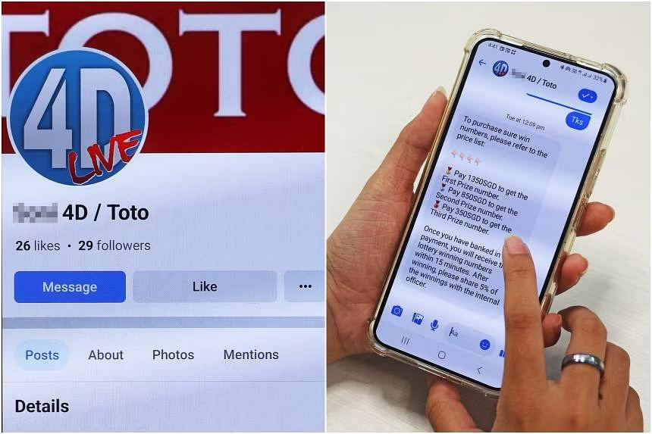
TECHNICAL MECHANISM
ARCH
Investment scam: attack chain
ENTRY
TRUST
ACTION
LOSS
Fabricated returns platform
guaranteed return
repeated deposits and blocked withdrawal
money · access · identity
OBSERVABLE SIGNALS
guaranteed return; social proof; withdrawal fee
Source-deck evidence
Break the path before disclosure, installation, authentication or payment.
Navigating Digital Threats · TGS-2024043420
© 2026 Tertiary Infotech Academy Pte Ltd
Source: police.gov.sg
35

Slide 36
EVIDENCE MODEL
MODEL
Investment scam: signal model
1
CHANNEL
2
PRESSURE
3
ACTION
How did it arrive?
What emotion is engineered?
What must you do?
Account, number, domain, redirect and device context
Authority, urgency, scarcity, fear, reward or secrecy
Disclose, install, authenticate, pay, forward or stay connected
DECIDE: move to an independently obtained contact route before taking the requested action.
Navigating Digital Threats · TGS-2024043420
© 2026 Tertiary Infotech Academy Pte Ltd
Source: occ.gov
36

Slide 37
WORKED CASE
CASE
Investment scam: evidence-led decision
CLAIM
Record exactly what the sender says. Identity cues remain unverified.
EVIDENCE
Capture sender, domain, number, URL, payment route, requested authentication and timing.
DISPOSITION
Block and report when independent verification fails or the requested action is high risk.
Inspect the source-deck artifact at readable scale
A polished message can still be fraudulent; the decision rests on verified evidence and action risk.
Navigating Digital Threats · TGS-2024043420
© 2026 Tertiary Infotech Academy Pte Ltd
Source: fortinet.com
37

Slide 38
TECHNICAL MECHANISM
ARCH
Job scam: attack chain
ENTRY
TRUST
ACTION
LOSS
TRUST BOUNDARY
Fake task or recruitment offer
easy income
advance payment and escalating deposits
money · access · identity
!
OBSERVABLE SIGNALS
easy income; group chat; pay to unlock commission
Stop and verify outside the sender-controlled channel
Break the path before disclosure, installation, authentication or payment.
Navigating Digital Threats · TGS-2024043420
© 2026 Tertiary Infotech Academy Pte Ltd
Source: police.gov.sg
38

Slide 39
EVIDENCE MODEL
MODEL
Job scam: signal model
1
CHANNEL
2
PRESSURE
3
ACTION
How did it arrive?
What emotion is engineered?
What must you do?
Account, number, domain, redirect and device context
Authority, urgency, scarcity, fear, reward or secrecy
Disclose, install, authenticate, pay, forward or stay connected
DECIDE: move to an independently obtained contact route before taking the requested action.
Navigating Digital Threats · TGS-2024043420
© 2026 Tertiary Infotech Academy Pte Ltd
Source: occ.gov
39

Slide 40
WORKED CASE
CASE
Job scam: evidence-led decision
EVIDENCE BOARD
CLAIM
Record exactly what the sender says. Identity cues remain unverified.
SENDER
CHANNEL
identity cue
origin and redirect
EVIDENCE
Capture sender, domain, number, URL, payment route, requested authentication and timing.
ACTION
ROUTE
data, access or payment
trusted verification
DISPOSITION
Block and report when independent verification fails or the requested action is high risk.
Record facts before deciding
A polished message can still be fraudulent; the decision rests on verified evidence and action risk.
Navigating Digital Threats · TGS-2024043420
© 2026 Tertiary Infotech Academy Pte Ltd
Source: fortinet.com
40

Slide 41
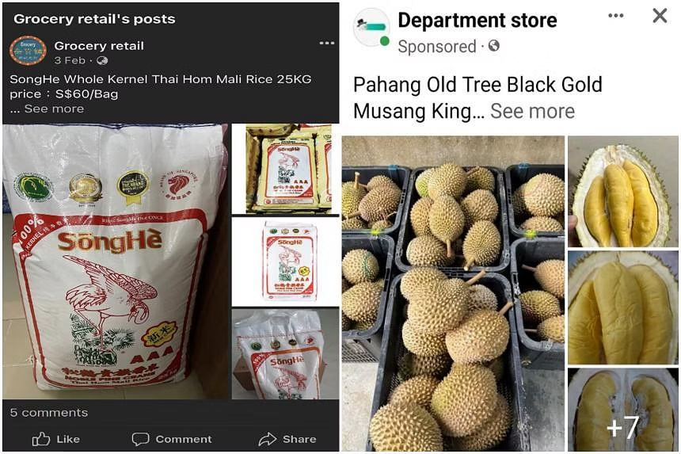
TECHNICAL MECHANISM
ARCH
E-commerce scam: attack chain
ENTRY
TRUST
ACTION
LOSS
Non-existent or misrepresented goods
off-platform chat
irreversible prepayment
money · access · identity
OBSERVABLE SIGNALS
off-platform chat; deposit; price anomaly
Source-deck evidence
Break the path before disclosure, installation, authentication or payment.
Navigating Digital Threats · TGS-2024043420
© 2026 Tertiary Infotech Academy Pte Ltd
Source: police.gov.sg
41

Slide 42
EVIDENCE MODEL
MODEL
E-commerce scam: signal model
1
CHANNEL
2
PRESSURE
3
ACTION
How did it arrive?
What emotion is engineered?
What must you do?
Account, number, domain, redirect and device context
Authority, urgency, scarcity, fear, reward or secrecy
Disclose, install, authenticate, pay, forward or stay connected
DECIDE: move to an independently obtained contact route before taking the requested action.
Navigating Digital Threats · TGS-2024043420
© 2026 Tertiary Infotech Academy Pte Ltd
Source: occ.gov
42

Slide 43
WORKED CASE
CASE
E-commerce scam: evidence-led decision
CLAIM
Record exactly what the sender says. Identity cues remain unverified.
EVIDENCE
Capture sender, domain, number, URL, payment route, requested authentication and timing.
DISPOSITION
Block and report when independent verification fails or the requested action is high risk.
Inspect the source-deck artifact at readable scale
A polished message can still be fraudulent; the decision rests on verified evidence and action risk.
Navigating Digital Threats · TGS-2024043420
© 2026 Tertiary Infotech Academy Pte Ltd
Source: fortinet.com
43

Slide 44
TECHNICAL MECHANISM
ARCH
Tech-support scam: attack chain
ENTRY
TRUST
ACTION
LOSS
TRUST BOUNDARY
False device infection
unsolicited alert
remote access and payment
money · access · identity
!
OBSERVABLE SIGNALS
unsolicited alert; remote tool; refund or clean-up fee
Stop and verify outside the sender-controlled channel
Break the path before disclosure, installation, authentication or payment.
Navigating Digital Threats · TGS-2024043420
© 2026 Tertiary Infotech Academy Pte Ltd
Source: police.gov.sg
44

Slide 45
EVIDENCE MODEL
MODEL
Tech-support scam: signal model
1
CHANNEL
2
PRESSURE
3
ACTION
How did it arrive?
What emotion is engineered?
What must you do?
Account, number, domain, redirect and device context
Authority, urgency, scarcity, fear, reward or secrecy
Disclose, install, authenticate, pay, forward or stay connected
DECIDE: move to an independently obtained contact route before taking the requested action.
Navigating Digital Threats · TGS-2024043420
© 2026 Tertiary Infotech Academy Pte Ltd
Source: occ.gov
45

Slide 46
WORKED CASE
CASE
Tech-support scam: evidence-led decision
EVIDENCE BOARD
CLAIM
Record exactly what the sender says. Identity cues remain unverified.
SENDER
CHANNEL
identity cue
origin and redirect
EVIDENCE
Capture sender, domain, number, URL, payment route, requested authentication and timing.
ACTION
ROUTE
data, access or payment
trusted verification
DISPOSITION
Block and report when independent verification fails or the requested action is high risk.
Record facts before deciding
A polished message can still be fraudulent; the decision rests on verified evidence and action risk.
Navigating Digital Threats · TGS-2024043420
© 2026 Tertiary Infotech Academy Pte Ltd
Source: fortinet.com
46

Slide 47
TECHNICAL MECHANISM
ARCH
Business email compromise: attack chain
ENTRY
TRUST
ACTION
LOSS
TRUST BOUNDARY
Compromised or spoofed mailbox
changed beneficiary
fraudulent supplier payment
money · access · identity
!
OBSERVABLE SIGNALS
changed beneficiary; urgency; process bypass
Stop and verify outside the sender-controlled channel
Break the path before disclosure, installation, authentication or payment.
Navigating Digital Threats · TGS-2024043420
© 2026 Tertiary Infotech Academy Pte Ltd
Source: police.gov.sg
47

Slide 48
EVIDENCE MODEL
MODEL
Business email compromise: signal model
1
CHANNEL
2
PRESSURE
3
ACTION
How did it arrive?
What emotion is engineered?
What must you do?
Account, number, domain, redirect and device context
Authority, urgency, scarcity, fear, reward or secrecy
Disclose, install, authenticate, pay, forward or stay connected
DECIDE: move to an independently obtained contact route before taking the requested action.
Navigating Digital Threats · TGS-2024043420
© 2026 Tertiary Infotech Academy Pte Ltd
Source: occ.gov
48

Slide 49
WORKED CASE
CASE
Business email compromise: evidence-led decision
EVIDENCE BOARD
CLAIM
Record exactly what the sender says. Identity cues remain unverified.
SENDER
CHANNEL
identity cue
origin and redirect
EVIDENCE
Capture sender, domain, number, URL, payment route, requested authentication and timing.
ACTION
ROUTE
data, access or payment
trusted verification
DISPOSITION
Block and report when independent verification fails or the requested action is high risk.
Record facts before deciding
A polished message can still be fraudulent; the decision rests on verified evidence and action risk.
Navigating Digital Threats · TGS-2024043420
© 2026 Tertiary Infotech Academy Pte Ltd
Source: fortinet.com
49

Slide 50
TECHNICAL MECHANISM
ARCH
Romance scam: attack chain
ENTRY
TRUST
ACTION
LOSS
TRUST BOUNDARY
Engineered emotional trust
rapid intimacy
progressive financial extraction
money · access · identity
!
OBSERVABLE SIGNALS
rapid intimacy; crisis; avoidance of live verification
Stop and verify outside the sender-controlled channel
Break the path before disclosure, installation, authentication or payment.
Navigating Digital Threats · TGS-2024043420
© 2026 Tertiary Infotech Academy Pte Ltd
Source: police.gov.sg
50

Slide 51
EVIDENCE MODEL
MODEL
Romance scam: signal model
1
CHANNEL
2
PRESSURE
3
ACTION
How did it arrive?
What emotion is engineered?
What must you do?
Account, number, domain, redirect and device context
Authority, urgency, scarcity, fear, reward or secrecy
Disclose, install, authenticate, pay, forward or stay connected
DECIDE: move to an independently obtained contact route before taking the requested action.
Navigating Digital Threats · TGS-2024043420
© 2026 Tertiary Infotech Academy Pte Ltd
Source: occ.gov
51

Slide 52
WORKED CASE
CASE
Romance scam: evidence-led decision
EVIDENCE BOARD
CLAIM
Record exactly what the sender says. Identity cues remain unverified.
SENDER
CHANNEL
identity cue
origin and redirect
EVIDENCE
Capture sender, domain, number, URL, payment route, requested authentication and timing.
ACTION
ROUTE
data, access or payment
trusted verification
DISPOSITION
Block and report when independent verification fails or the requested action is high risk.
Record facts before deciding
A polished message can still be fraudulent; the decision rests on verified evidence and action risk.
Navigating Digital Threats · TGS-2024043420
© 2026 Tertiary Infotech Academy Pte Ltd
Source: fortinet.com
52

Slide 53
TECHNICAL MECHANISM
ARCH
Malware-enabled scam: attack chain
ENTRY
TRUST
ACTION
LOSS
TRUST BOUNDARY
Sideloaded or disguised application
unknown-source app
session theft and device control
money · access · identity
!
OBSERVABLE SIGNALS
unknown-source app; accessibility permissions; overlay
Stop and verify outside the sender-controlled channel
Break the path before disclosure, installation, authentication or payment.
Navigating Digital Threats · TGS-2024043420
© 2026 Tertiary Infotech Academy Pte Ltd
Source: police.gov.sg
53

Slide 54
EVIDENCE MODEL
MODEL
Malware-enabled scam: signal model
1
CHANNEL
2
PRESSURE
3
ACTION
How did it arrive?
What emotion is engineered?
What must you do?
Account, number, domain, redirect and device context
Authority, urgency, scarcity, fear, reward or secrecy
Disclose, install, authenticate, pay, forward or stay connected
DECIDE: move to an independently obtained contact route before taking the requested action.
Navigating Digital Threats · TGS-2024043420
© 2026 Tertiary Infotech Academy Pte Ltd
Source: occ.gov
54

Slide 55
WORKED CASE
CASE
Malware-enabled scam: evidence-led decision
EVIDENCE BOARD
CLAIM
Record exactly what the sender says. Identity cues remain unverified.
SENDER
CHANNEL
identity cue
origin and redirect
EVIDENCE
Capture sender, domain, number, URL, payment route, requested authentication and timing.
ACTION
ROUTE
data, access or payment
trusted verification
DISPOSITION
Block and report when independent verification fails or the requested action is high risk.
Record facts before deciding
A polished message can still be fraudulent; the decision rests on verified evidence and action risk.
Navigating Digital Threats · TGS-2024043420
© 2026 Tertiary Infotech Academy Pte Ltd
Source: fortinet.com
55

Slide 56
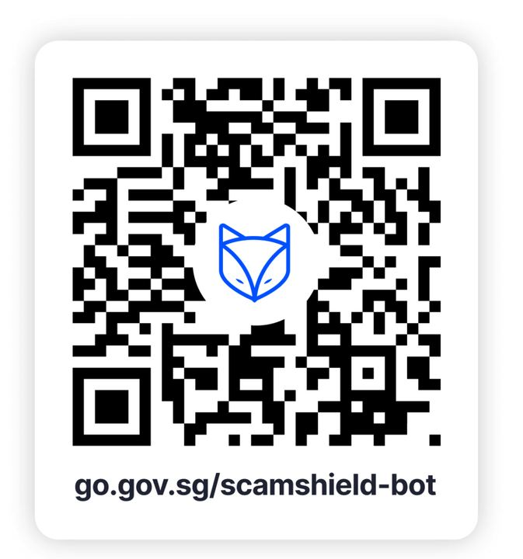
TECHNICAL MECHANISM
ARCH
QR phishing: attack chain
ENTRY
TRUST
ACTION
LOSS
Malicious QR destination
unverifiable code
hidden redirect to fake service
money · access · identity
OBSERVABLE SIGNALS
unverifiable code; payment/login request; domain mismatch
Source-deck evidence
Break the path before disclosure, installation, authentication or payment.
Navigating Digital Threats · TGS-2024043420
© 2026 Tertiary Infotech Academy Pte Ltd
Source: police.gov.sg
56

Slide 57
EVIDENCE MODEL
MODEL
QR phishing: signal model
1
CHANNEL
2
PRESSURE
3
ACTION
How did it arrive?
What emotion is engineered?
What must you do?
Account, number, domain, redirect and device context
Authority, urgency, scarcity, fear, reward or secrecy
Disclose, install, authenticate, pay, forward or stay connected
DECIDE: move to an independently obtained contact route before taking the requested action.
Navigating Digital Threats · TGS-2024043420
© 2026 Tertiary Infotech Academy Pte Ltd
Source: occ.gov
57

Slide 58
WORKED CASE
CASE
QR phishing: evidence-led decision
CLAIM
Record exactly what the sender says. Identity cues remain unverified.
EVIDENCE
Capture sender, domain, number, URL, payment route, requested authentication and timing.
DISPOSITION
Block and report when independent verification fails or the requested action is high risk.
Inspect the source-deck artifact at readable scale
A polished message can still be fraudulent; the decision rests on verified evidence and action risk.
Navigating Digital Threats · TGS-2024043420
© 2026 Tertiary Infotech Academy Pte Ltd
Source: fortinet.com
58

Slide 59
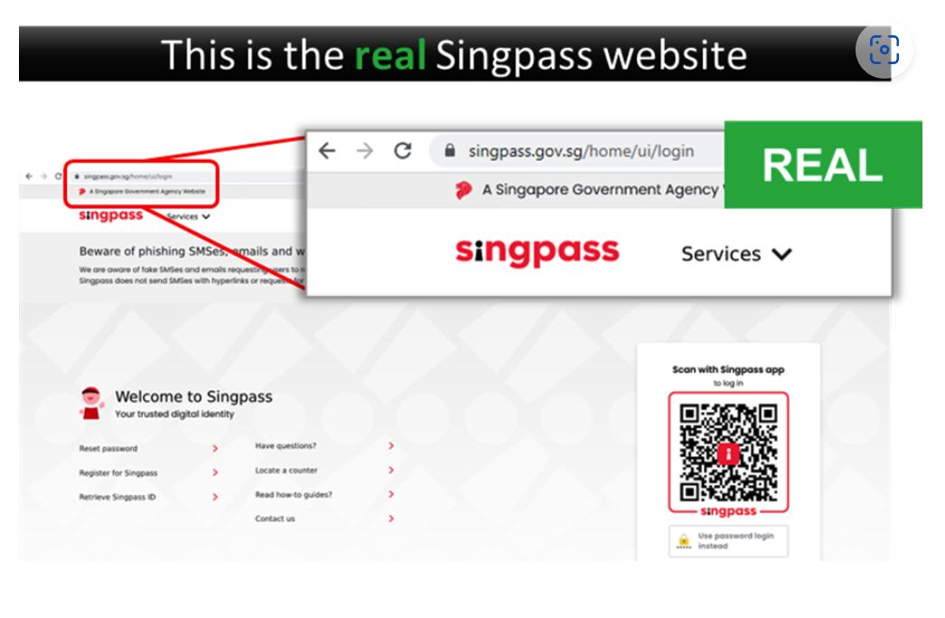
TECHNICAL MECHANISM
ARCH
Account takeover: attack chain
ENTRY
TRUST
ACTION
LOSS
Stolen credentials or session
new device
impersonation and onward fraud
money · access · identity
OBSERVABLE SIGNALS
new device; recovery change; unusual messages
Source-deck evidence
Break the path before disclosure, installation, authentication or payment.
Navigating Digital Threats · TGS-2024043420
© 2026 Tertiary Infotech Academy Pte Ltd
Source: police.gov.sg
59

Slide 60
EVIDENCE MODEL
MODEL
Account takeover: signal model
1
CHANNEL
2
PRESSURE
3
ACTION
How did it arrive?
What emotion is engineered?
What must you do?
Account, number, domain, redirect and device context
Authority, urgency, scarcity, fear, reward or secrecy
Disclose, install, authenticate, pay, forward or stay connected
DECIDE: move to an independently obtained contact route before taking the requested action.
Navigating Digital Threats · TGS-2024043420
© 2026 Tertiary Infotech Academy Pte Ltd
Source: occ.gov
60

Slide 61
WORKED CASE
CASE
Account takeover: evidence-led decision
CLAIM
Record exactly what the sender says. Identity cues remain unverified.
EVIDENCE
Capture sender, domain, number, URL, payment route, requested authentication and timing.
DISPOSITION
Block and report when independent verification fails or the requested action is high risk.
Inspect the source-deck artifact at readable scale
A polished message can still be fraudulent; the decision rests on verified evidence and action risk.
Navigating Digital Threats · TGS-2024043420
© 2026 Tertiary Infotech Academy Pte Ltd
Source: fortinet.com
61

Slide 62
TECHNICAL MECHANISM
ARCH
Money-mule recruitment: attack chain
ENTRY
TRUST
ACTION
LOSS
TRUST BOUNDARY
Use of personal accounts to move funds
keep commission
laundering and legal exposure
money · access · identity
!
OBSERVABLE SIGNALS
keep commission; receive and forward; secrecy
Stop and verify outside the sender-controlled channel
Break the path before disclosure, installation, authentication or payment.
Navigating Digital Threats · TGS-2024043420
© 2026 Tertiary Infotech Academy Pte Ltd
Source: police.gov.sg
62

Slide 63
EVIDENCE MODEL
MODEL
Money-mule recruitment: signal model
1
CHANNEL
2
PRESSURE
3
ACTION
How did it arrive?
What emotion is engineered?
What must you do?
Account, number, domain, redirect and device context
Authority, urgency, scarcity, fear, reward or secrecy
Disclose, install, authenticate, pay, forward or stay connected
DECIDE: move to an independently obtained contact route before taking the requested action.
Navigating Digital Threats · TGS-2024043420
© 2026 Tertiary Infotech Academy Pte Ltd
Source: occ.gov
63

Slide 64
WORKED CASE
CASE
Money-mule recruitment: evidence-led decision
EVIDENCE BOARD
CLAIM
Record exactly what the sender says. Identity cues remain unverified.
SENDER
CHANNEL
identity cue
origin and redirect
EVIDENCE
Capture sender, domain, number, URL, payment route, requested authentication and timing.
ACTION
ROUTE
data, access or payment
trusted verification
DISPOSITION
Block and report when independent verification fails or the requested action is high risk.
Record facts before deciding
A polished message can still be fraudulent; the decision rests on verified evidence and action risk.
Navigating Digital Threats · TGS-2024043420
© 2026 Tertiary Infotech Academy Pte Ltd
Source: fortinet.com
64

Slide 65
TECHNICAL MECHANISM
ARCH
Lottery and prize scam: attack chain
ENTRY
TRUST
ACTION
LOSS
TRUST BOUNDARY
False reward notification
unexpected win
fee and identity extraction
money · access · identity
!
OBSERVABLE SIGNALS
unexpected win; tax or delivery fee; urgency
Stop and verify outside the sender-controlled channel
Break the path before disclosure, installation, authentication or payment.
Navigating Digital Threats · TGS-2024043420
© 2026 Tertiary Infotech Academy Pte Ltd
Source: police.gov.sg
65

Slide 66
EVIDENCE MODEL
MODEL
Lottery and prize scam: signal model
1
CHANNEL
2
PRESSURE
3
ACTION
How did it arrive?
What emotion is engineered?
What must you do?
Account, number, domain, redirect and device context
Authority, urgency, scarcity, fear, reward or secrecy
Disclose, install, authenticate, pay, forward or stay connected
DECIDE: move to an independently obtained contact route before taking the requested action.
Navigating Digital Threats · TGS-2024043420
© 2026 Tertiary Infotech Academy Pte Ltd
Source: occ.gov
66

Slide 67
WORKED CASE
CASE
Lottery and prize scam: evidence-led decision
EVIDENCE BOARD
CLAIM
Record exactly what the sender says. Identity cues remain unverified.
SENDER
CHANNEL
identity cue
origin and redirect
EVIDENCE
Capture sender, domain, number, URL, payment route, requested authentication and timing.
ACTION
ROUTE
data, access or payment
trusted verification
DISPOSITION
Block and report when independent verification fails or the requested action is high risk.
Record facts before deciding
A polished message can still be fraudulent; the decision rests on verified evidence and action risk.
Navigating Digital Threats · TGS-2024043420
© 2026 Tertiary Infotech Academy Pte Ltd
Source: fortinet.com
67

Slide 68
TECHNICAL MECHANISM
ARCH
Loan scam: attack chain
ENTRY
TRUST
ACTION
LOSS
TRUST BOUNDARY
False low-cost credit offer
guaranteed approval
advance fee and identity theft
money · access · identity
!
OBSERVABLE SIGNALS
guaranteed approval; processing fee; unofficial channel
Stop and verify outside the sender-controlled channel
Break the path before disclosure, installation, authentication or payment.
Navigating Digital Threats · TGS-2024043420
© 2026 Tertiary Infotech Academy Pte Ltd
Source: police.gov.sg
68

Slide 69
EVIDENCE MODEL
MODEL
Loan scam: signal model
1
CHANNEL
2
PRESSURE
3
ACTION
How did it arrive?
What emotion is engineered?
What must you do?
Account, number, domain, redirect and device context
Authority, urgency, scarcity, fear, reward or secrecy
Disclose, install, authenticate, pay, forward or stay connected
DECIDE: move to an independently obtained contact route before taking the requested action.
Navigating Digital Threats · TGS-2024043420
© 2026 Tertiary Infotech Academy Pte Ltd
Source: occ.gov
69

Slide 70
WORKED CASE
CASE
Loan scam: evidence-led decision
EVIDENCE BOARD
CLAIM
Record exactly what the sender says. Identity cues remain unverified.
SENDER
CHANNEL
identity cue
origin and redirect
EVIDENCE
Capture sender, domain, number, URL, payment route, requested authentication and timing.
ACTION
ROUTE
data, access or payment
trusted verification
DISPOSITION
Block and report when independent verification fails or the requested action is high risk.
Record facts before deciding
A polished message can still be fraudulent; the decision rests on verified evidence and action risk.
Navigating Digital Threats · TGS-2024043420
© 2026 Tertiary Infotech Academy Pte Ltd
Source: fortinet.com
70

Slide 71
TECHNICAL MECHANISM
ARCH
Deepfake impersonation: attack chain
ENTRY
TRUST
ACTION
LOSS
TRUST BOUNDARY
Synthetic voice or video
unusual request
high-trust payment manipulation
money · access · identity
!
OBSERVABLE SIGNALS
unusual request; channel shift; no independent callback
Stop and verify outside the sender-controlled channel
Break the path before disclosure, installation, authentication or payment.
Navigating Digital Threats · TGS-2024043420
© 2026 Tertiary Infotech Academy Pte Ltd
Source: police.gov.sg
71

Slide 72
EVIDENCE MODEL
MODEL
Deepfake impersonation: signal model
1
CHANNEL
2
PRESSURE
3
ACTION
How did it arrive?
What emotion is engineered?
What must you do?
Account, number, domain, redirect and device context
Authority, urgency, scarcity, fear, reward or secrecy
Disclose, install, authenticate, pay, forward or stay connected
DECIDE: move to an independently obtained contact route before taking the requested action.
Navigating Digital Threats · TGS-2024043420
© 2026 Tertiary Infotech Academy Pte Ltd
Source: occ.gov
72

Slide 73
WORKED CASE
CASE
Deepfake impersonation: evidence-led decision
EVIDENCE BOARD
CLAIM
Record exactly what the sender says. Identity cues remain unverified.
SENDER
CHANNEL
identity cue
origin and redirect
EVIDENCE
Capture sender, domain, number, URL, payment route, requested authentication and timing.
ACTION
ROUTE
data, access or payment
trusted verification
DISPOSITION
Block and report when independent verification fails or the requested action is high risk.
Record facts before deciding
A polished message can still be fraudulent; the decision rests on verified evidence and action risk.
Navigating Digital Threats · TGS-2024043420
© 2026 Tertiary Infotech Academy Pte Ltd
Source: fortinet.com
73

Slide 74

TOPIC 02
Assess and Protect Information
Layer controls around identity, devices, accounts and payments so one mistake does not become a loss.
02
Navigating Digital Threats · TGS-2024043420
© 2026 Tertiary Infotech Academy Pte Ltd
74

Slide 75
PROTECTIVE CONTROL
CONFIG
Independent verification
CONTROL INTENT
Move to contact data obtained outside the suspicious message
ATTACK PATH INTERRUPTED
Breaks the scammer-controlled trust path
PROOF TO RETAIN
Enabled state · owner · timestamp · residual risk — with secrets redacted
Control evidence
Navigating Digital Threats · TGS-2024043420
© 2026 Tertiary Infotech Academy Pte Ltd
Source: bitdefender.com
75

Slide 76
VERIFICATION EVIDENCE
EVIDENCE
Independent verification: control test
1
2
3
4
TRIGGER
CONTROL
EVIDENCE
RECOVERY
Urgent request, unusual login or changed payment instruction
Challenge, block, limit or independently verify the action
Observable result, owner, timestamp and remaining exposure
Escalate if absent, bypassed, misconfigured or ambiguous
PASS only when the expected control response is visible and the evidence is safe to retain.
Navigating Digital Threats · TGS-2024043420
© 2026 Tertiary Infotech Academy Pte Ltd
Source: scamshield.gov.sg
76

Slide 77
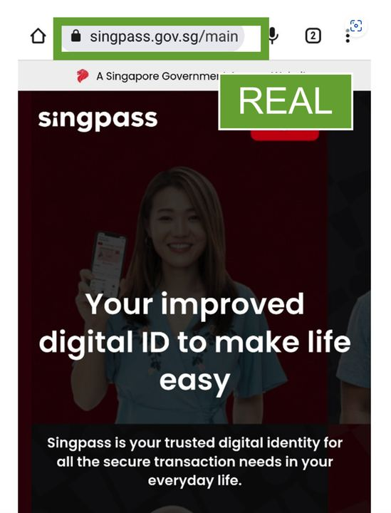
PROTECTIVE CONTROL
CONFIG
Passkeys and phishing-resistant MFA
CONTROL INTENT
Bind authentication to the legitimate origin and device
ATTACK PATH INTERRUPTED
Reduces credential replay and OTP interception
PROOF TO RETAIN
Enabled state · owner · timestamp · residual risk — with secrets redacted
Control evidence
Navigating Digital Threats · TGS-2024043420
© 2026 Tertiary Infotech Academy Pte Ltd
Source: bitdefender.com
77

Slide 78
VERIFICATION EVIDENCE
EVIDENCE
Passkeys and phishing-resistant MFA: control test
1
2
3
4
TRIGGER
CONTROL
EVIDENCE
RECOVERY
Urgent request, unusual login or changed payment instruction
Challenge, block, limit or independently verify the action
Observable result, owner, timestamp and remaining exposure
Escalate if absent, bypassed, misconfigured or ambiguous
PASS only when the expected control response is visible and the evidence is safe to retain.
Navigating Digital Threats · TGS-2024043420
© 2026 Tertiary Infotech Academy Pte Ltd
Source: scamshield.gov.sg
78

Slide 79
PROTECTIVE CONTROL
CONFIG
Password manager
CONTROL INTENT
LAYERED CONTROL
Generate unique credentials and match saved origins
REQUEST
treat as unverified
VERIFY
use a trusted route
ATTACK PATH INTERRUPTED
Prevents password reuse and exposes look-alike domains
AUTHORISE
apply the control
MONITOR
retain safe evidence
PROOF TO RETAIN
Enabled state · owner · timestamp · residual risk — with secrets redacted
Navigating Digital Threats · TGS-2024043420
© 2026 Tertiary Infotech Academy Pte Ltd
Source: bitdefender.com
79

Slide 80
VERIFICATION EVIDENCE
EVIDENCE
Password manager: control test
1
2
3
4
TRIGGER
CONTROL
EVIDENCE
RECOVERY
Urgent request, unusual login or changed payment instruction
Challenge, block, limit or independently verify the action
Observable result, owner, timestamp and remaining exposure
Escalate if absent, bypassed, misconfigured or ambiguous
PASS only when the expected control response is visible and the evidence is safe to retain.
Navigating Digital Threats · TGS-2024043420
© 2026 Tertiary Infotech Academy Pte Ltd
Source: scamshield.gov.sg
80

Slide 81
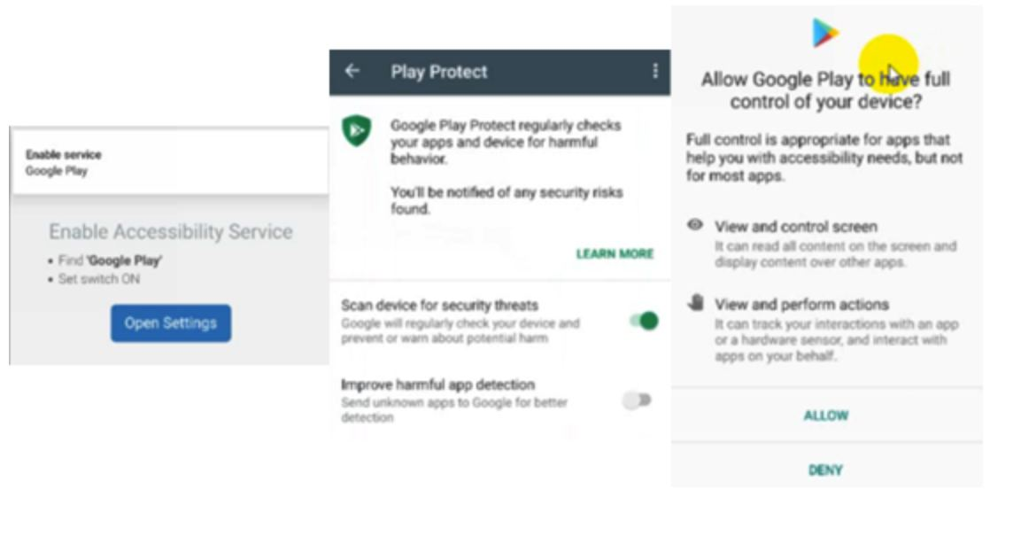
PROTECTIVE CONTROL
CONFIG
Device patching
CONTROL INTENT
Apply supported operating-system and browser fixes
ATTACK PATH INTERRUPTED
Removes known exploit paths used by malicious sites and apps
PROOF TO RETAIN
Enabled state · owner · timestamp · residual risk — with secrets redacted
Control evidence
Navigating Digital Threats · TGS-2024043420
© 2026 Tertiary Infotech Academy Pte Ltd
Source: bitdefender.com
81

Slide 82
VERIFICATION EVIDENCE
EVIDENCE
Device patching: control test
1
2
3
4
TRIGGER
CONTROL
EVIDENCE
RECOVERY
Urgent request, unusual login or changed payment instruction
Challenge, block, limit or independently verify the action
Observable result, owner, timestamp and remaining exposure
Escalate if absent, bypassed, misconfigured or ambiguous
PASS only when the expected control response is visible and the evidence is safe to retain.
Navigating Digital Threats · TGS-2024043420
© 2026 Tertiary Infotech Academy Pte Ltd
Source: scamshield.gov.sg
82

Slide 83
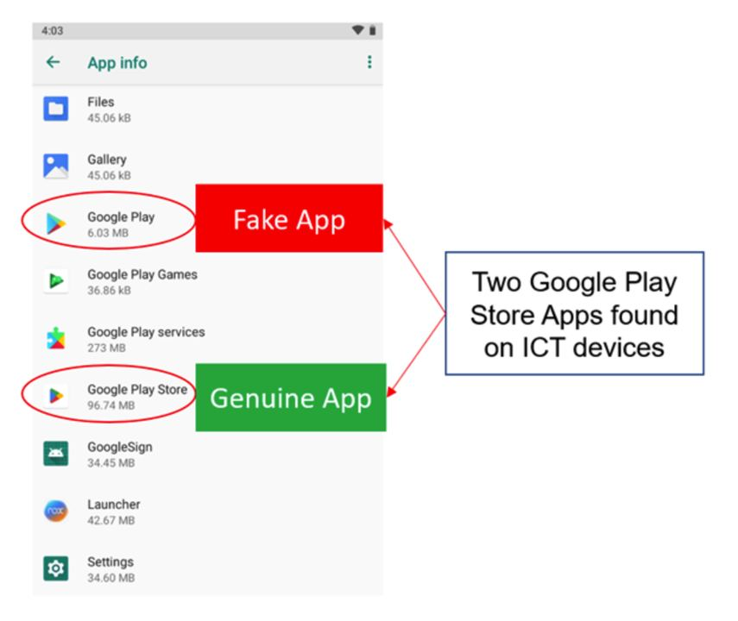
PROTECTIVE CONTROL
CONFIG
Unknown-source restriction
CONTROL INTENT
Block sideloading and risky accessibility permissions
ATTACK PATH INTERRUPTED
Interrupts malware-enabled scam installation
PROOF TO RETAIN
Enabled state · owner · timestamp · residual risk — with secrets redacted
Control evidence
Navigating Digital Threats · TGS-2024043420
© 2026 Tertiary Infotech Academy Pte Ltd
Source: bitdefender.com
83

Slide 84
VERIFICATION EVIDENCE
EVIDENCE
Unknown-source restriction: control test
1
2
3
4
TRIGGER
CONTROL
EVIDENCE
RECOVERY
Urgent request, unusual login or changed payment instruction
Challenge, block, limit or independently verify the action
Observable result, owner, timestamp and remaining exposure
Escalate if absent, bypassed, misconfigured or ambiguous
PASS only when the expected control response is visible and the evidence is safe to retain.
Navigating Digital Threats · TGS-2024043420
© 2026 Tertiary Infotech Academy Pte Ltd
Source: scamshield.gov.sg
84

Slide 85
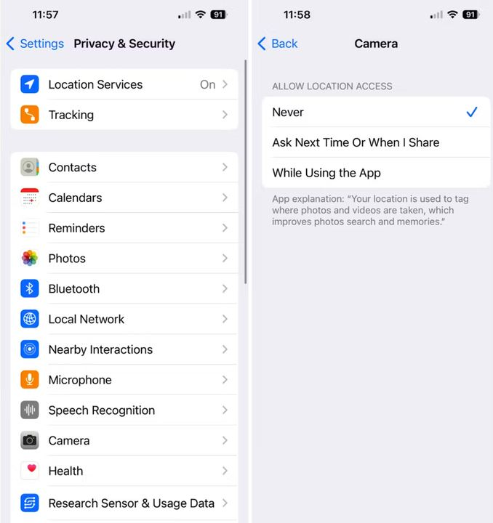
PROTECTIVE CONTROL
CONFIG
Session review
CONTROL INTENT
Inspect devices, sessions, forwarding and recovery changes
ATTACK PATH INTERRUPTED
Detects persistence after credential compromise
PROOF TO RETAIN
Enabled state · owner · timestamp · residual risk — with secrets redacted
Control evidence
Navigating Digital Threats · TGS-2024043420
© 2026 Tertiary Infotech Academy Pte Ltd
Source: bitdefender.com
85

Slide 86
VERIFICATION EVIDENCE
EVIDENCE
Session review: control test
1
2
3
4
TRIGGER
CONTROL
EVIDENCE
RECOVERY
Urgent request, unusual login or changed payment instruction
Challenge, block, limit or independently verify the action
Observable result, owner, timestamp and remaining exposure
Escalate if absent, bypassed, misconfigured or ambiguous
PASS only when the expected control response is visible and the evidence is safe to retain.
Navigating Digital Threats · TGS-2024043420
© 2026 Tertiary Infotech Academy Pte Ltd
Source: scamshield.gov.sg
86

Slide 87
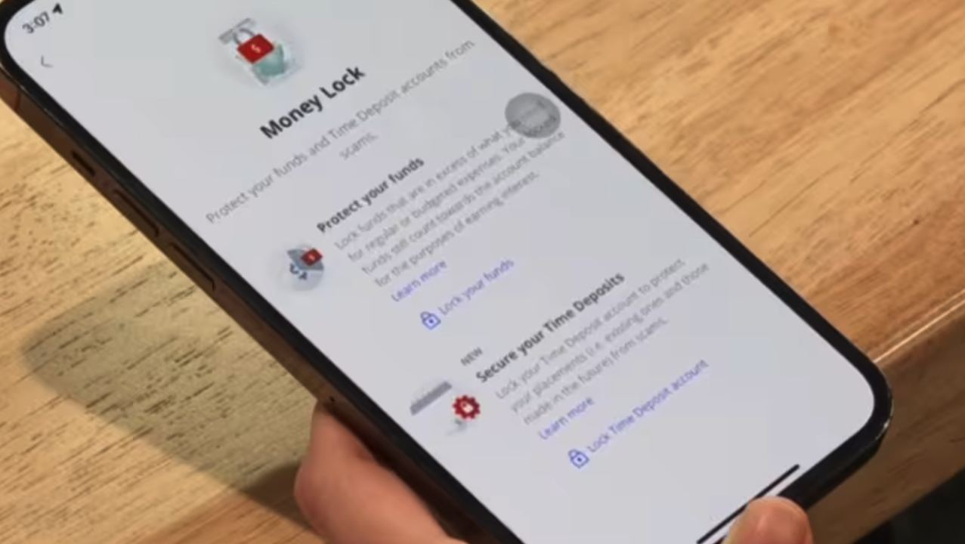
PROTECTIVE CONTROL
CONFIG
Transaction alerts
CONTROL INTENT
Notify immediately on transfers, payees and card activity
ATTACK PATH INTERRUPTED
Shortens detection and bank-contact time
PROOF TO RETAIN
Enabled state · owner · timestamp · residual risk — with secrets redacted
Control evidence
Navigating Digital Threats · TGS-2024043420
© 2026 Tertiary Infotech Academy Pte Ltd
Source: bitdefender.com
87

Slide 88
VERIFICATION EVIDENCE
EVIDENCE
Transaction alerts: control test
1
2
3
4
TRIGGER
CONTROL
EVIDENCE
RECOVERY
Urgent request, unusual login or changed payment instruction
Challenge, block, limit or independently verify the action
Observable result, owner, timestamp and remaining exposure
Escalate if absent, bypassed, misconfigured or ambiguous
PASS only when the expected control response is visible and the evidence is safe to retain.
Navigating Digital Threats · TGS-2024043420
© 2026 Tertiary Infotech Academy Pte Ltd
Source: scamshield.gov.sg
88

Slide 89
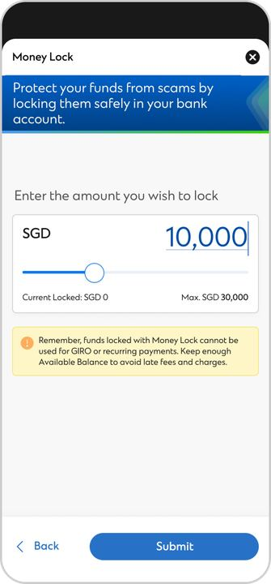
PROTECTIVE CONTROL
CONFIG
Transfer limits
CONTROL INTENT
Cap routine exposure and require deliberate changes
ATTACK PATH INTERRUPTED
Reduces maximum loss from one compromised session
PROOF TO RETAIN
Enabled state · owner · timestamp · residual risk — with secrets redacted
Control evidence
Navigating Digital Threats · TGS-2024043420
© 2026 Tertiary Infotech Academy Pte Ltd
Source: bitdefender.com
89

Slide 90
VERIFICATION EVIDENCE
EVIDENCE
Transfer limits: control test
1
2
3
4
TRIGGER
CONTROL
EVIDENCE
RECOVERY
Urgent request, unusual login or changed payment instruction
Challenge, block, limit or independently verify the action
Observable result, owner, timestamp and remaining exposure
Escalate if absent, bypassed, misconfigured or ambiguous
PASS only when the expected control response is visible and the evidence is safe to retain.
Navigating Digital Threats · TGS-2024043420
© 2026 Tertiary Infotech Academy Pte Ltd
Source: scamshield.gov.sg
90

Slide 91
PROTECTIVE CONTROL
CONFIG
Money Lock
CONTROL INTENT
LAYERED CONTROL
Separate protected funds from digitally transferable balances
REQUEST
treat as unverified
VERIFY
use a trusted route
ATTACK PATH INTERRUPTED
Limits funds reachable through online compromise
AUTHORISE
apply the control
MONITOR
retain safe evidence
PROOF TO RETAIN
Enabled state · owner · timestamp · residual risk — with secrets redacted
Navigating Digital Threats · TGS-2024043420
© 2026 Tertiary Infotech Academy Pte Ltd
Source: bitdefender.com
91

Slide 92
VERIFICATION EVIDENCE
EVIDENCE
Money Lock: control test
1
2
3
4
TRIGGER
CONTROL
EVIDENCE
RECOVERY
Urgent request, unusual login or changed payment instruction
Challenge, block, limit or independently verify the action
Observable result, owner, timestamp and remaining exposure
Escalate if absent, bypassed, misconfigured or ambiguous
PASS only when the expected control response is visible and the evidence is safe to retain.
Navigating Digital Threats · TGS-2024043420
© 2026 Tertiary Infotech Academy Pte Ltd
Source: scamshield.gov.sg
92

Slide 93
PROTECTIVE CONTROL
CONFIG
Maker-checker approval
CONTROL INTENT
LAYERED CONTROL
Separate request, verification and payment release
REQUEST
treat as unverified
VERIFY
use a trusted route
ATTACK PATH INTERRUPTED
Stops a single compromised mailbox from authorising payment
AUTHORISE
apply the control
MONITOR
retain safe evidence
PROOF TO RETAIN
Enabled state · owner · timestamp · residual risk — with secrets redacted
Navigating Digital Threats · TGS-2024043420
© 2026 Tertiary Infotech Academy Pte Ltd
Source: bitdefender.com
93

Slide 94
VERIFICATION EVIDENCE
EVIDENCE
Maker-checker approval: control test
1
2
3
4
TRIGGER
CONTROL
EVIDENCE
RECOVERY
Urgent request, unusual login or changed payment instruction
Challenge, block, limit or independently verify the action
Observable result, owner, timestamp and remaining exposure
Escalate if absent, bypassed, misconfigured or ambiguous
PASS only when the expected control response is visible and the evidence is safe to retain.
Navigating Digital Threats · TGS-2024043420
© 2026 Tertiary Infotech Academy Pte Ltd
Source: scamshield.gov.sg
94

Slide 95
PROTECTIVE CONTROL
CONFIG
Beneficiary callback
CONTROL INTENT
LAYERED CONTROL
Verify account changes through a known channel
REQUEST
treat as unverified
VERIFY
use a trusted route
ATTACK PATH INTERRUPTED
Targets business email compromise and invoice diversion
AUTHORISE
apply the control
MONITOR
retain safe evidence
PROOF TO RETAIN
Enabled state · owner · timestamp · residual risk — with secrets redacted
Navigating Digital Threats · TGS-2024043420
© 2026 Tertiary Infotech Academy Pte Ltd
Source: bitdefender.com
95

Slide 96
VERIFICATION EVIDENCE
EVIDENCE
Beneficiary callback: control test
1
2
3
4
TRIGGER
CONTROL
EVIDENCE
RECOVERY
Urgent request, unusual login or changed payment instruction
Challenge, block, limit or independently verify the action
Observable result, owner, timestamp and remaining exposure
Escalate if absent, bypassed, misconfigured or ambiguous
PASS only when the expected control response is visible and the evidence is safe to retain.
Navigating Digital Threats · TGS-2024043420
© 2026 Tertiary Infotech Academy Pte Ltd
Source: scamshield.gov.sg
96

Slide 97
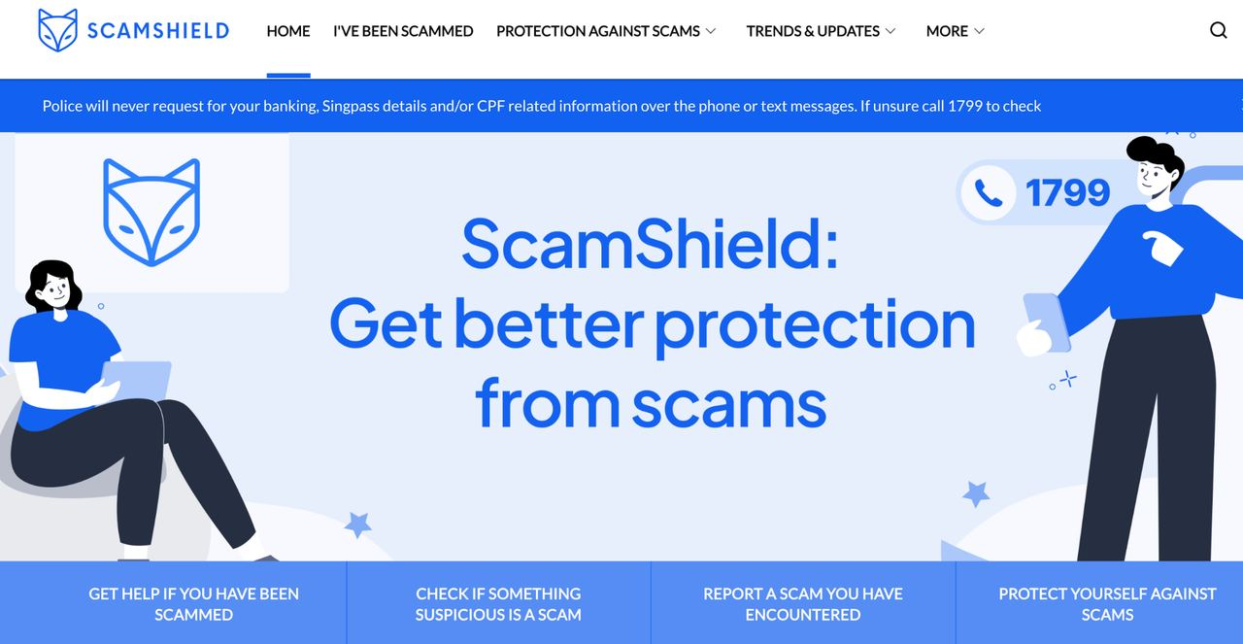
PROTECTIVE CONTROL
CONFIG
ScamShield
CONTROL INTENT
Check and report suspicious numbers, messages and links
ATTACK PATH INTERRUPTED
Adds community and SPF-informed detection signals
PROOF TO RETAIN
Enabled state · owner · timestamp · residual risk — with secrets redacted
Control evidence
Navigating Digital Threats · TGS-2024043420
© 2026 Tertiary Infotech Academy Pte Ltd
Source: bitdefender.com
97

Slide 98
VERIFICATION EVIDENCE
EVIDENCE
ScamShield: control test
1
2
3
4
TRIGGER
CONTROL
EVIDENCE
RECOVERY
Urgent request, unusual login or changed payment instruction
Challenge, block, limit or independently verify the action
Observable result, owner, timestamp and remaining exposure
Escalate if absent, bypassed, misconfigured or ambiguous
PASS only when the expected control response is visible and the evidence is safe to retain.
Navigating Digital Threats · TGS-2024043420
© 2026 Tertiary Infotech Academy Pte Ltd
Source: scamshield.gov.sg
98

Slide 99
PROTECTIVE CONTROL
CONFIG
Privacy minimisation
CONTROL INTENT
LAYERED CONTROL
Limit public identity, role and relationship data
REQUEST
treat as unverified
VERIFY
use a trusted route
ATTACK PATH INTERRUPTED
Reduces material available for tailored pretexts
AUTHORISE
apply the control
MONITOR
retain safe evidence
PROOF TO RETAIN
Enabled state · owner · timestamp · residual risk — with secrets redacted
Navigating Digital Threats · TGS-2024043420
© 2026 Tertiary Infotech Academy Pte Ltd
Source: bitdefender.com
99

Slide 100
VERIFICATION EVIDENCE
EVIDENCE
Privacy minimisation: control test
1
2
3
4
TRIGGER
CONTROL
EVIDENCE
RECOVERY
Urgent request, unusual login or changed payment instruction
Challenge, block, limit or independently verify the action
Observable result, owner, timestamp and remaining exposure
Escalate if absent, bypassed, misconfigured or ambiguous
PASS only when the expected control response is visible and the evidence is safe to retain.
Navigating Digital Threats · TGS-2024043420
© 2026 Tertiary Infotech Academy Pte Ltd
Source: scamshield.gov.sg
100

Slide 101
PROTECTIVE CONTROL
CONFIG
Offline backup
CONTROL INTENT
LAYERED CONTROL
Keep tested, disconnected recovery copies
REQUEST
treat as unverified
VERIFY
use a trusted route
ATTACK PATH INTERRUPTED
Reduces ransomware leverage and preserves business continuity
AUTHORISE
apply the control
MONITOR
retain safe evidence
PROOF TO RETAIN
Enabled state · owner · timestamp · residual risk — with secrets redacted
Navigating Digital Threats · TGS-2024043420
© 2026 Tertiary Infotech Academy Pte Ltd
Source: bitdefender.com
101

Slide 102
VERIFICATION EVIDENCE
EVIDENCE
Offline backup: control test
1
2
3
4
TRIGGER
CONTROL
EVIDENCE
RECOVERY
Urgent request, unusual login or changed payment instruction
Challenge, block, limit or independently verify the action
Observable result, owner, timestamp and remaining exposure
Escalate if absent, bypassed, misconfigured or ambiguous
PASS only when the expected control response is visible and the evidence is safe to retain.
Navigating Digital Threats · TGS-2024043420
© 2026 Tertiary Infotech Academy Pte Ltd
Source: scamshield.gov.sg
102

Slide 103
PROTECTIVE CONTROL
CONFIG
Incident rehearsal
CONTROL INTENT
LAYERED CONTROL
Practice evidence, bank, police and internal escalation
REQUEST
treat as unverified
VERIFY
use a trusted route
ATTACK PATH INTERRUPTED
Reduces delay and omissions under pressure
AUTHORISE
apply the control
MONITOR
retain safe evidence
PROOF TO RETAIN
Enabled state · owner · timestamp · residual risk — with secrets redacted
Navigating Digital Threats · TGS-2024043420
© 2026 Tertiary Infotech Academy Pte Ltd
Source: bitdefender.com
103

Slide 104
VERIFICATION EVIDENCE
EVIDENCE
Incident rehearsal: control test
1
2
3
4
TRIGGER
CONTROL
EVIDENCE
RECOVERY
Urgent request, unusual login or changed payment instruction
Challenge, block, limit or independently verify the action
Observable result, owner, timestamp and remaining exposure
Escalate if absent, bypassed, misconfigured or ambiguous
PASS only when the expected control response is visible and the evidence is safe to retain.
Navigating Digital Threats · TGS-2024043420
© 2026 Tertiary Infotech Academy Pte Ltd
Source: scamshield.gov.sg
104

Slide 105
HANDS-ON BRIDGE
ACTIVITY
Activity 1: Scam Signal Triage
01
Classify a suspicious contact using channel, claim, pressure, requested action and payment route.
SCENARIO
YOU WILL PRODUCE
ACCEPTANCE
Use the supplied fictional case and worksheet.
Completed signal matrix with risk score and decision rationale.
Every decision cites at least two observable indicators; no decision relies only on spelling or grammar.
Detailed procedure: Learner Guide and activities/activity-01-scam-signal-triage/ACTIVITY-GUIDE.md
Navigating Digital Threats · TGS-2024043420
© 2026 Tertiary Infotech Academy Pte Ltd
activities/activity-01-scam-signal-triage/ACTIVITY-GUIDE.md
105

Slide 106
HANDS-ON BRIDGE
ACTIVITY
Activity 2: Phishing URL and Header Analysis
02
Inspect a simulated phishing message without opening its link or attachment.
SCENARIO
YOU WILL PRODUCE
ACCEPTANCE
Use the supplied fictional case and worksheet.
Annotated header and URL decomposition with disposition.
The registrable domain and authentication result are stated correctly and no live suspect link is opened.
Detailed procedure: Learner Guide and activities/activity-02-phishing-url-header-analysis/ACTIVITY-GUIDE.md
Navigating Digital Threats · TGS-2024043420
© 2026 Tertiary Infotech Academy Pte Ltd
activities/activity-02-phishing-url-header-analysis/ACTIVITY-GUIDE.md
106

Slide 107
HANDS-ON BRIDGE
ACTIVITY
Activity 3: Independent Verification Drill
03
Break the scammer-controlled channel and verify a claim through trusted contact data.
SCENARIO
YOU WILL PRODUCE
ACCEPTANCE
Use the supplied fictional case and worksheet.
Verification log and trust-boundary explanation.
No sender-provided telephone number, link or QR code is used for verification.
Detailed procedure: Learner Guide and activities/activity-03-independent-verification/ACTIVITY-GUIDE.md
Navigating Digital Threats · TGS-2024043420
© 2026 Tertiary Infotech Academy Pte Ltd
activities/activity-03-independent-verification/ACTIVITY-GUIDE.md
107

Slide 108
HANDS-ON BRIDGE
ACTIVITY
Activity 4: Account and Device Hardening
04
Apply layered safeguards that reduce credential, session and malware-enabled fraud.
SCENARIO
YOU WILL PRODUCE
ACCEPTANCE
Use the supplied fictional case and worksheet.
Hardening checklist with redacted screenshots and residual risks.
Credentials and recovery codes are absent; each control names the attack path it interrupts.
Detailed procedure: Learner Guide and activities/activity-04-account-device-hardening/ACTIVITY-GUIDE.md
Navigating Digital Threats · TGS-2024043420
© 2026 Tertiary Infotech Academy Pte Ltd
activities/activity-04-account-device-hardening/ACTIVITY-GUIDE.md
108

Slide 109
HANDS-ON BRIDGE
ACTIVITY
Activity 5: ScamShield Check and Report
05
Use ScamShield resources to check and report a simulated suspicious message safely.
SCENARIO
YOU WILL PRODUCE
ACCEPTANCE
Use the supplied fictional case and worksheet.
ScamShield check record, redacted report example and limitations note.
Only simulated data is submitted; the learner distinguishes a tool result from proof of legitimacy.
Detailed procedure: Learner Guide and activities/activity-05-scamshield-check-report/ACTIVITY-GUIDE.md
Navigating Digital Threats · TGS-2024043420
© 2026 Tertiary Infotech Academy Pte Ltd
activities/activity-05-scamshield-check-report/ACTIVITY-GUIDE.md
109

Slide 110
HANDS-ON BRIDGE
ACTIVITY
Activity 6: Financial Control Plan
06
Design preventive and detective controls for a personal or small-business payment workflow.
SCENARIO
YOU WILL PRODUCE
ACCEPTANCE
Use the supplied fictional case and worksheet.
Payment control map, approval matrix and scenario test result.
The design separates request, verification and approval, and names at least one preventive and one detective control.
Detailed procedure: Learner Guide and activities/activity-06-financial-control-plan/ACTIVITY-GUIDE.md
Navigating Digital Threats · TGS-2024043420
© 2026 Tertiary Infotech Academy Pte Ltd
activities/activity-06-financial-control-plan/ACTIVITY-GUIDE.md
110

Slide 111

TOPIC 03
Respond to Cyber Security Threats
Contain loss, preserve the timeline and route verified facts to the parties able to act.
03
Navigating Digital Threats · TGS-2024043420
© 2026 Tertiary Infotech Academy Pte Ltd
111

Slide 112
INCIDENT RESPONSE
PROCESS
Stop interaction
01 · ACTION
End calls and messages; do not follow new instructions
RESPONSE CHECKPOINT
NOW
contain the active risk
WHY THIS ORDER
prevents further coercion and data disclosure
NEXT
preserve and secure
THEN
report and track
EVIDENCE
Time · owner · reference number · source item · observable outcome
Navigating Digital Threats · TGS-2024043420
© 2026 Tertiary Infotech Academy Pte Ltd
Source: scamshield.gov.sg
112

Slide 113
DECISION MODEL
DECISION
Stop interaction: escalation check
SEVERITY MATRIX
ROUTE VERIFIED FACTS
MONITOR
VERIFY
BANK
protect funds
Low impact Known scope
High uncertainty No confirmed loss
PLATFORM
remove abuse
CONTAIN
ESCALATE
report evidence
SCAMSHIELD / POLICE
Confirmed compromise Limited impact
Financial loss, data exposure or multiple victims
INTERNAL TEAMS
coordinate response
Handoff test: chronology + evidence IDs + confirmed facts + impact + clear request
Navigating Digital Threats · TGS-2024043420
© 2026 Tertiary Infotech Academy Pte Ltd
Source: police.gov.sg
113

Slide 114
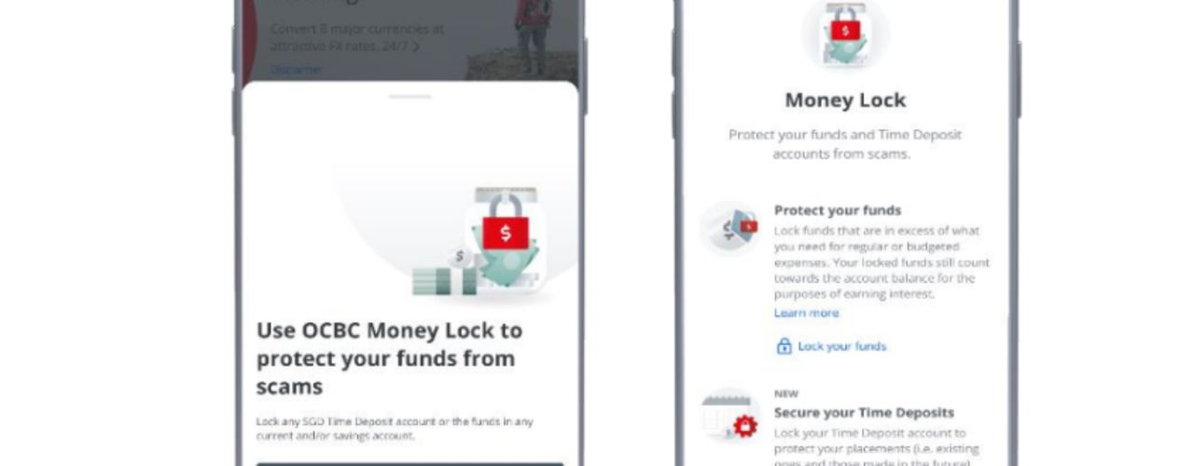
INCIDENT RESPONSE
PROCESS
Protect money
01 · ACTION
Contact the bank through an official channel and request urgent action
WHY THIS ORDER
maximises the chance of stopping or tracing transfers
EVIDENCE
Time · owner · reference number · source item · observable outcome
Operational evidence
Navigating Digital Threats · TGS-2024043420
© 2026 Tertiary Infotech Academy Pte Ltd
Source: scamshield.gov.sg
114

Slide 115
DECISION MODEL
DECISION
Protect money: escalation check
SEVERITY MATRIX
ROUTE VERIFIED FACTS
MONITOR
VERIFY
BANK
protect funds
Low impact Known scope
High uncertainty No confirmed loss
PLATFORM
remove abuse
CONTAIN
ESCALATE
report evidence
SCAMSHIELD / POLICE
Confirmed compromise Limited impact
Financial loss, data exposure or multiple victims
INTERNAL TEAMS
coordinate response
Handoff test: chronology + evidence IDs + confirmed facts + impact + clear request
Navigating Digital Threats · TGS-2024043420
© 2026 Tertiary Infotech Academy Pte Ltd
Source: police.gov.sg
115

Slide 116
INCIDENT RESPONSE
PROCESS
Isolate compromise
01 · ACTION
Disconnect a suspected infected device while preserving state
RESPONSE CHECKPOINT
NOW
contain the active risk
WHY THIS ORDER
limits attacker access without erasing evidence
NEXT
preserve and secure
THEN
report and track
EVIDENCE
Time · owner · reference number · source item · observable outcome
Navigating Digital Threats · TGS-2024043420
© 2026 Tertiary Infotech Academy Pte Ltd
Source: scamshield.gov.sg
116

Slide 117
DECISION MODEL
DECISION
Isolate compromise: escalation check
SEVERITY MATRIX
ROUTE VERIFIED FACTS
MONITOR
VERIFY
BANK
protect funds
Low impact Known scope
High uncertainty No confirmed loss
PLATFORM
remove abuse
CONTAIN
ESCALATE
report evidence
SCAMSHIELD / POLICE
Confirmed compromise Limited impact
Financial loss, data exposure or multiple victims
INTERNAL TEAMS
coordinate response
Handoff test: chronology + evidence IDs + confirmed facts + impact + clear request
Navigating Digital Threats · TGS-2024043420
© 2026 Tertiary Infotech Academy Pte Ltd
Source: police.gov.sg
117

Slide 118
INCIDENT RESPONSE
PROCESS
Preserve evidence
01 · ACTION
Save originals, screenshots, headers, numbers, URLs and transaction references
RESPONSE CHECKPOINT
NOW
contain the active risk
WHY THIS ORDER
supports bank, platform and police action
NEXT
preserve and secure
THEN
report and track
EVIDENCE
Time · owner · reference number · source item · observable outcome
Navigating Digital Threats · TGS-2024043420
© 2026 Tertiary Infotech Academy Pte Ltd
Source: scamshield.gov.sg
118

Slide 119
DECISION MODEL
DECISION
Preserve evidence: escalation check
SEVERITY MATRIX
ROUTE VERIFIED FACTS
MONITOR
VERIFY
BANK
protect funds
Low impact Known scope
High uncertainty No confirmed loss
PLATFORM
remove abuse
CONTAIN
ESCALATE
report evidence
SCAMSHIELD / POLICE
Confirmed compromise Limited impact
Financial loss, data exposure or multiple victims
INTERNAL TEAMS
coordinate response
Handoff test: chronology + evidence IDs + confirmed facts + impact + clear request
Navigating Digital Threats · TGS-2024043420
© 2026 Tertiary Infotech Academy Pte Ltd
Source: police.gov.sg
119

Slide 120
INCIDENT RESPONSE
PROCESS
Secure accounts
01 · ACTION
Change exposed credentials from a trusted device and revoke sessions
RESPONSE CHECKPOINT
NOW
contain the active risk
WHY THIS ORDER
closes reused credentials and stolen sessions
NEXT
preserve and secure
THEN
report and track
EVIDENCE
Time · owner · reference number · source item · observable outcome
Navigating Digital Threats · TGS-2024043420
© 2026 Tertiary Infotech Academy Pte Ltd
Source: scamshield.gov.sg
120

Slide 121
DECISION MODEL
DECISION
Secure accounts: escalation check
SEVERITY MATRIX
ROUTE VERIFIED FACTS
MONITOR
VERIFY
BANK
protect funds
Low impact Known scope
High uncertainty No confirmed loss
PLATFORM
remove abuse
CONTAIN
ESCALATE
report evidence
SCAMSHIELD / POLICE
Confirmed compromise Limited impact
Financial loss, data exposure or multiple victims
INTERNAL TEAMS
coordinate response
Handoff test: chronology + evidence IDs + confirmed facts + impact + clear request
Navigating Digital Threats · TGS-2024043420
© 2026 Tertiary Infotech Academy Pte Ltd
Source: police.gov.sg
121

Slide 122
INCIDENT RESPONSE
PROCESS
Assess scope
01 · ACTION
Identify people, accounts, devices, data and payments affected
RESPONSE CHECKPOINT
NOW
contain the active risk
WHY THIS ORDER
sets severity and notification priorities
NEXT
preserve and secure
THEN
report and track
EVIDENCE
Time · owner · reference number · source item · observable outcome
Navigating Digital Threats · TGS-2024043420
© 2026 Tertiary Infotech Academy Pte Ltd
Source: scamshield.gov.sg
122

Slide 123
DECISION MODEL
DECISION
Assess scope: escalation check
SEVERITY MATRIX
ROUTE VERIFIED FACTS
MONITOR
VERIFY
BANK
protect funds
Low impact Known scope
High uncertainty No confirmed loss
PLATFORM
remove abuse
CONTAIN
ESCALATE
report evidence
SCAMSHIELD / POLICE
Confirmed compromise Limited impact
Financial loss, data exposure or multiple victims
INTERNAL TEAMS
coordinate response
Handoff test: chronology + evidence IDs + confirmed facts + impact + clear request
Navigating Digital Threats · TGS-2024043420
© 2026 Tertiary Infotech Academy Pte Ltd
Source: police.gov.sg
123

Slide 124
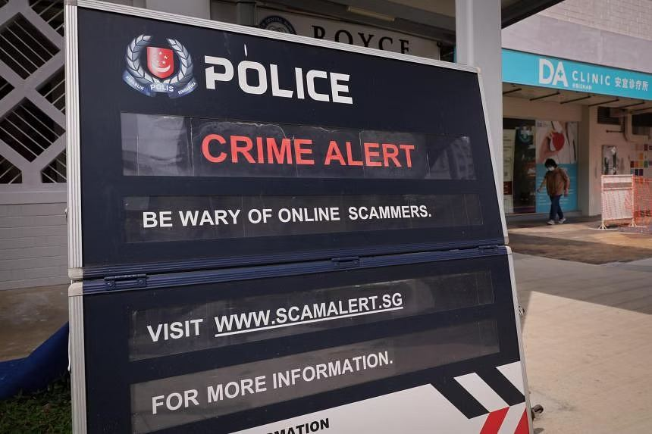
INCIDENT RESPONSE
PROCESS
Report platform abuse
01 · ACTION
Use the platform reporting path for the account, advert, message or listing
WHY THIS ORDER
enables removal and ecosystem disruption
EVIDENCE
Time · owner · reference number · source item · observable outcome
Operational evidence
Navigating Digital Threats · TGS-2024043420
© 2026 Tertiary Infotech Academy Pte Ltd
Source: scamshield.gov.sg
124

Slide 125
DECISION MODEL
DECISION
Report platform abuse: escalation check
SEVERITY MATRIX
ROUTE VERIFIED FACTS
MONITOR
VERIFY
BANK
protect funds
Low impact Known scope
High uncertainty No confirmed loss
PLATFORM
remove abuse
CONTAIN
ESCALATE
report evidence
SCAMSHIELD / POLICE
Confirmed compromise Limited impact
Financial loss, data exposure or multiple victims
INTERNAL TEAMS
coordinate response
Handoff test: chronology + evidence IDs + confirmed facts + impact + clear request
Navigating Digital Threats · TGS-2024043420
© 2026 Tertiary Infotech Academy Pte Ltd
Source: police.gov.sg
125

Slide 126
INCIDENT RESPONSE
PROCESS
Use ScamShield
01 · ACTION
Check or report suspicious contact through official ScamShield resources
WHY THIS ORDER
contributes signals and receives current advice
EVIDENCE
Time · owner · reference number · source item · observable outcome
Operational evidence
Navigating Digital Threats · TGS-2024043420
© 2026 Tertiary Infotech Academy Pte Ltd
Source: scamshield.gov.sg
126

Slide 127
DECISION MODEL
DECISION
Use ScamShield: escalation check
SEVERITY MATRIX
ROUTE VERIFIED FACTS
MONITOR
VERIFY
BANK
protect funds
Low impact Known scope
High uncertainty No confirmed loss
PLATFORM
remove abuse
CONTAIN
ESCALATE
report evidence
SCAMSHIELD / POLICE
Confirmed compromise Limited impact
Financial loss, data exposure or multiple victims
INTERNAL TEAMS
coordinate response
Handoff test: chronology + evidence IDs + confirmed facts + impact + clear request
Navigating Digital Threats · TGS-2024043420
© 2026 Tertiary Infotech Academy Pte Ltd
Source: police.gov.sg
127

Slide 128
INCIDENT RESPONSE
PROCESS
Make a Police report
01 · ACTION
Provide a factual chronology and supporting evidence
RESPONSE CHECKPOINT
NOW
contain the active risk
WHY THIS ORDER
creates an official record and supports investigation
NEXT
preserve and secure
THEN
report and track
EVIDENCE
Time · owner · reference number · source item · observable outcome
Navigating Digital Threats · TGS-2024043420
© 2026 Tertiary Infotech Academy Pte Ltd
Source: scamshield.gov.sg
128

Slide 129
DECISION MODEL
DECISION
Make a Police report: escalation check
SEVERITY MATRIX
ROUTE VERIFIED FACTS
MONITOR
VERIFY
BANK
protect funds
Low impact Known scope
High uncertainty No confirmed loss
PLATFORM
remove abuse
CONTAIN
ESCALATE
report evidence
SCAMSHIELD / POLICE
Confirmed compromise Limited impact
Financial loss, data exposure or multiple victims
INTERNAL TEAMS
coordinate response
Handoff test: chronology + evidence IDs + confirmed facts + impact + clear request
Navigating Digital Threats · TGS-2024043420
© 2026 Tertiary Infotech Academy Pte Ltd
Source: police.gov.sg
129

Slide 130
INCIDENT RESPONSE
PROCESS
Notify the workplace
01 · ACTION
Engage security, finance, legal and data-protection roles as applicable
RESPONSE CHECKPOINT
NOW
contain the active risk
WHY THIS ORDER
coordinates containment and statutory decisions
NEXT
preserve and secure
THEN
report and track
EVIDENCE
Time · owner · reference number · source item · observable outcome
Navigating Digital Threats · TGS-2024043420
© 2026 Tertiary Infotech Academy Pte Ltd
Source: scamshield.gov.sg
130

Slide 131
DECISION MODEL
DECISION
Notify the workplace: escalation check
SEVERITY MATRIX
ROUTE VERIFIED FACTS
MONITOR
VERIFY
BANK
protect funds
Low impact Known scope
High uncertainty No confirmed loss
PLATFORM
remove abuse
CONTAIN
ESCALATE
report evidence
SCAMSHIELD / POLICE
Confirmed compromise Limited impact
Financial loss, data exposure or multiple victims
INTERNAL TEAMS
coordinate response
Handoff test: chronology + evidence IDs + confirmed facts + impact + clear request
Navigating Digital Threats · TGS-2024043420
© 2026 Tertiary Infotech Academy Pte Ltd
Source: police.gov.sg
131

Slide 132
INCIDENT RESPONSE
PROCESS
Track recovery
01 · ACTION
Maintain actions, owners, reference numbers and outcomes
RESPONSE CHECKPOINT
NOW
contain the active risk
WHY THIS ORDER
prevents gaps and supports handoffs
NEXT
preserve and secure
THEN
report and track
EVIDENCE
Time · owner · reference number · source item · observable outcome
Navigating Digital Threats · TGS-2024043420
© 2026 Tertiary Infotech Academy Pte Ltd
Source: scamshield.gov.sg
132

Slide 133
DECISION MODEL
DECISION
Track recovery: escalation check
SEVERITY MATRIX
ROUTE VERIFIED FACTS
MONITOR
VERIFY
BANK
protect funds
Low impact Known scope
High uncertainty No confirmed loss
PLATFORM
remove abuse
CONTAIN
ESCALATE
report evidence
SCAMSHIELD / POLICE
Confirmed compromise Limited impact
Financial loss, data exposure or multiple victims
INTERNAL TEAMS
coordinate response
Handoff test: chronology + evidence IDs + confirmed facts + impact + clear request
Navigating Digital Threats · TGS-2024043420
© 2026 Tertiary Infotech Academy Pte Ltd
Source: police.gov.sg
133

Slide 134
INCIDENT RESPONSE
PROCESS
Review controls
01 · ACTION
Convert the incident into owned corrective actions
RESPONSE CHECKPOINT
NOW
contain the active risk
WHY THIS ORDER
reduces recurrence and tests whether controls work
NEXT
preserve and secure
THEN
report and track
EVIDENCE
Time · owner · reference number · source item · observable outcome
Navigating Digital Threats · TGS-2024043420
© 2026 Tertiary Infotech Academy Pte Ltd
Source: scamshield.gov.sg
134

Slide 135
DECISION MODEL
DECISION
Review controls: escalation check
SEVERITY MATRIX
ROUTE VERIFIED FACTS
MONITOR
VERIFY
BANK
protect funds
Low impact Known scope
High uncertainty No confirmed loss
PLATFORM
remove abuse
CONTAIN
ESCALATE
report evidence
SCAMSHIELD / POLICE
Confirmed compromise Limited impact
Financial loss, data exposure or multiple victims
INTERNAL TEAMS
coordinate response
Handoff test: chronology + evidence IDs + confirmed facts + impact + clear request
Navigating Digital Threats · TGS-2024043420
© 2026 Tertiary Infotech Academy Pte Ltd
Source: police.gov.sg
135

Slide 136
HANDS-ON BRIDGE
ACTIVITY
Activity 7: Incident Evidence Pack
07
Preserve useful evidence and start containment without destroying the incident timeline.
SCENARIO
YOU WILL PRODUCE
ACCEPTANCE
Use the supplied fictional case and worksheet.
Incident timeline, evidence register and initial containment record.
The chronology is complete, evidence remains unaltered, and containment actions are distinguished from eradication.
Detailed procedure: Learner Guide and activities/activity-07-incident-evidence-pack/ACTIVITY-GUIDE.md
Navigating Digital Threats · TGS-2024043420
© 2026 Tertiary Infotech Academy Pte Ltd
activities/activity-07-incident-evidence-pack/ACTIVITY-GUIDE.md
136

Slide 137
HANDS-ON BRIDGE
ACTIVITY
Activity 8: Escalation Tabletop
08
Route a scam incident to the right internal and external parties using severity and evidence.
SCENARIO
YOU WILL PRODUCE
ACCEPTANCE
Use the supplied fictional case and worksheet.
Escalation matrix, incident brief, notification sequence and after-action actions.
The brief separates facts from assumptions and includes timestamps, evidence references, impact and a clear request.
Detailed procedure: Learner Guide and activities/activity-08-escalation-tabletop/ACTIVITY-GUIDE.md
Navigating Digital Threats · TGS-2024043420
© 2026 Tertiary Infotech Academy Pte Ltd
activities/activity-08-escalation-tabletop/ACTIVITY-GUIDE.md
137

Slide 138
TOPIC 04
Assessment and Close
Apply the same evidence models, controls and escalation logic used across the eight activities.
04
Navigating Digital Threats · TGS-2024043420
© 2026 Tertiary Infotech Academy Pte Ltd
138

Slide 139
CLOSING
ADMIN
Written Assessment
✓
Three open-ended questions mapped to K1–K3.
Use verified channels · protect credentials and funds · preserve evidence · escalate with facts
Navigating Digital Threats · TGS-2024043420
© 2026 Tertiary Infotech Academy Pte Ltd
Source: lms-tms.tertiaryinfotech.com
139

Slide 140
CLOSING
ADMIN
Case Study
✓
One coherent scenario with three questions mapped to A1–A3.
Use verified channels · protect credentials and funds · preserve evidence · escalate with facts
Navigating Digital Threats · TGS-2024043420
© 2026 Tertiary Infotech Academy Pte Ltd
Source: lms-tms.tertiaryinfotech.com
140

Slide 141
CLOSING
PROCESS
Assessment Flow
1
2
3
4
5
TRAQOM
Assessment attendance
WA then CS
Submit on LMS
Sign summary
Scan the LMS QR
Complete the SSG record
3 questions each
Upload responses
Review result and feedback
ATTENDANCE
MANDATORY
OPEN BOOK
EVIDENCE
RECORD
Candidate papers are learner-facing; answer keys remain trainer-only.
Navigating Digital Threats · TGS-2024043420
© 2026 Tertiary Infotech Academy Pte Ltd
Source: lms-tms.tertiaryinfotech.com
141

Slide 142
CLOSING
ADMIN
Digital Attendance (Mandatory)
✓
Complete the assessment attendance using the trainer-provided SSG QR code.
Use verified channels · protect credentials and funds · preserve evidence · escalate with facts
Navigating Digital Threats · TGS-2024043420
© 2026 Tertiary Infotech Academy Pte Ltd
Source: lms-tms.tertiaryinfotech.com
142

Slide 143
CLOSING
ADMIN
TRAQOM and Course Feedback
✓
Complete the course feedback and required TRAQOM survey through the LMS.
Use verified channels · protect credentials and funds · preserve evidence · escalate with facts
Navigating Digital Threats · TGS-2024043420
© 2026 Tertiary Infotech Academy Pte Ltd
Source: lms-tms.tertiaryinfotech.com
143

Slide 144
CLOSING
ADMIN
Thank You
✓
Stay calm, break the attacker-controlled channel, verify independently and preserve evidence.
Use verified channels · protect credentials and funds · preserve evidence · escalate with facts
Navigating Digital Threats · TGS-2024043420
© 2026 Tertiary Infotech Academy Pte Ltd
Source: lms-tms.tertiaryinfotech.com
144

